Slide 1


Slide 2
Table Of Contents
01
02
Our team
The idea
03
04
Step at work
Technologies

Slide 3
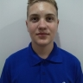
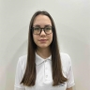
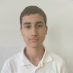
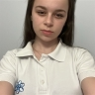
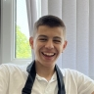
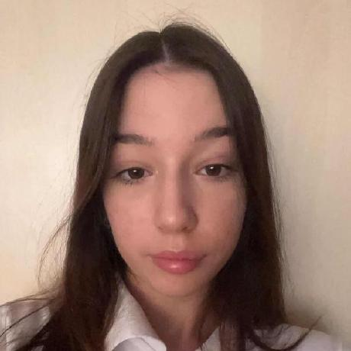
Our team
Aleksandar
Sivkov
10B
Ani
Vezirova
9G
Valentin
Lazarov
10G
Dariq
Kartalova
9G
Stanimir
Popov
10B
Kalina
Atanasova
9V

Slide 4
The idea:

Slide 5







Technologies

Slide 6
Thanks!

